Slide 1



MICRO PROJECT – DESIGN AND ANALYSIS OF ALGORITHM
Visualizing Strongly Connected Components with Kosaraju’s Algorithm
PROJECT MEMBER
RUPESH K R
( 23ITR139 )
JAIHARI D
Notes:
30 June 2023
1-59
1

Slide 2


There is a lack of interactive tools to help visualize Strongly Connected Components (SCCs) in directed graphs.
Most available resources provide only theoretical or static explanations, making it hard for learners to grasp SCC algorithms.
Understanding algorithms like Kosaraju's can be challenging without visual aids or step-by-step guidance.
There is a need for a user-friendly platform to build, manipulate, and analyze directed graphs in real-time.
The goal is to create a graph editor and SCC visualizer that enables step-wise animation and exploration of SCCs interactively.

Slide 3
Algorithm Design technique
Graph Traversal – Utilizes Depth First Search (DFS) to explore nodes and determine finishing times.
Divide and Conquer – Splits the problem into two DFS passes: one on the original graph and one on the transposed graph.
Greedy Approach – Assumes visiting nodes in reverse finishing order yields correct SCC grouping.
Graph Transposition – Builds a reversed version of the graph to explore connections in the opposite direction.
Component Grouping – Collects nodes into SCCs using recursive DFS, grouping all reachable nodes together.
3

Slide 4
Deciding on Appropriate Data Structures
Adjacency List
Efficient for representing sparse graphs.
Used to store edges for each node in both original and transposed graphs.
Stack
Used to keep track of node finishing order in the first DFS.
Helps in processing nodes in correct order for the second DFS.
Set (or Boolean Array)
Keeps track of visited nodes during DFS traversals.
Avoids redundant exploration and ensures correctness.

Slide 5
4.Array/List of Components
Stores the final list of strongly connected components.
Each SCC is a group (array) of node IDs.
5.Map/Object for Node Coloring (in visualization)
Maps each node to a color representing its SCC.
Helps visually distinguish SCCs on the graph.

Slide 6
Input Size and Efficiency Class
Input Size
Let V be the number of vertices (nodes)
Let E be the number of edges
The algorithm works efficiently for sparse to dense directed graphs
Time Complexity
O(V + E)
Kosaraju’s algorithm runs two full DFS traversals (one on the graph and one on the transposed graph)
Each edge and vertex is visited once per traversal
Space Complexity
O(V + E) for storing the adjacency list and its transpose
O(V) for stack, visited set, and SCC grouping

Slide 7
Input Size and Efficiency Class
4.Scalability
Performs well for medium to large graphs
Suitable for interactive visualizations due to linear complexity
5.Best Use Cases
Efficient in analyzing connectivity in software dependency graphs, control flow graphs, or network analysis

Slide 8
Implementation Details
Tech Stack
Frontend: React + TailwindCSS for dynamic UI and responsive design
Graph Drawing: react-flow-renderer for creating and manipulating nodes and edges
Algorithm: Kosaraju’s SCC implemented in pure JavaScript
User Interaction
Users can add nodes, connect them with directed edges
Interactive buttons: Run Kosaraju, Reset, and Add Node
Algorithm Integration
Graph is internally stored as an adjacency list
Kosaraju’s logic is triggered via a button press, which computes SCCs and highlights them with different colors
Styling and Responsiveness
TailwindCSS used for styling UI components
Fully responsive layout with clean design for clarity and usability
Animation and Feedback
React Flow provides smooth edge animation
Highlighted strongly connected components enhance visual feedback for algorithm steps

Slide 9
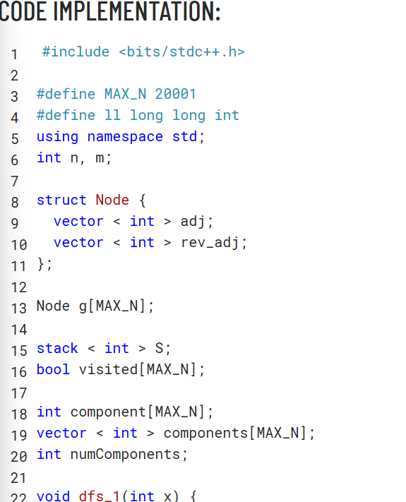
SAMPLE INPUT AND OUTPUT

Slide 10
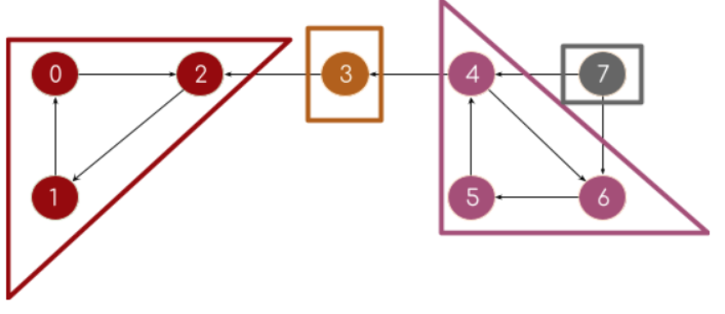
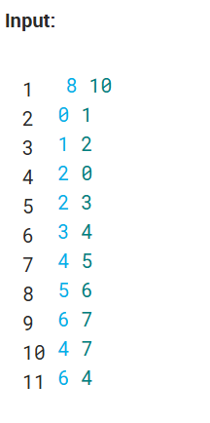
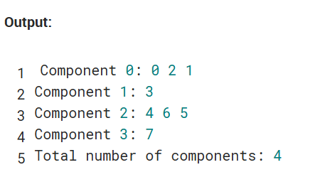

Slide 11
THANK YOU!!!

